Slide 1
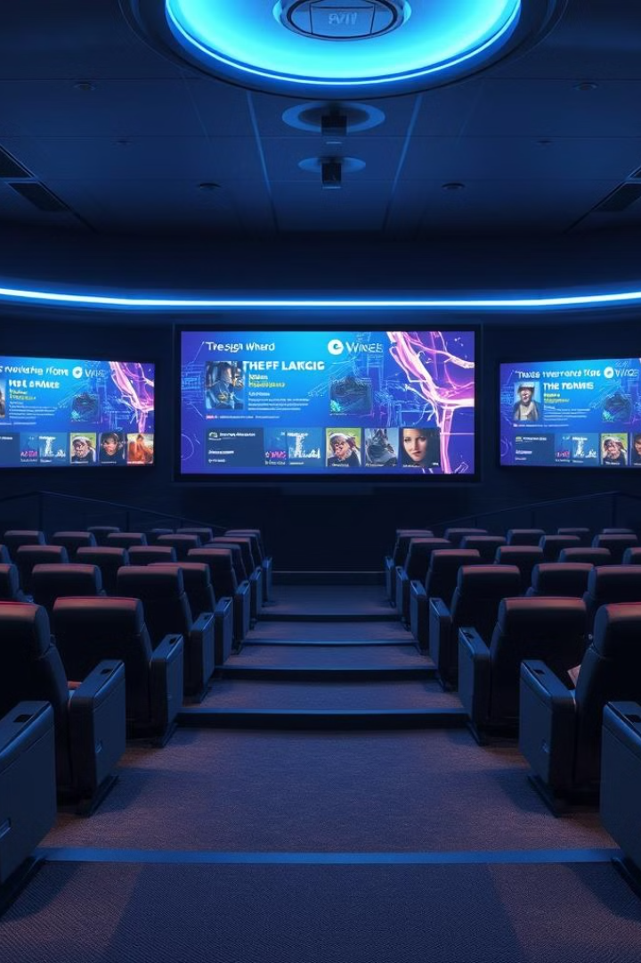
Personalized Movie Recommendation System
Our project leverages GANs and autoencoders to generate personalized movie recommendations. It integrates a FastAPI backend for real-time user interactions and uses scikit-learn for preprocessing.

Slide 2
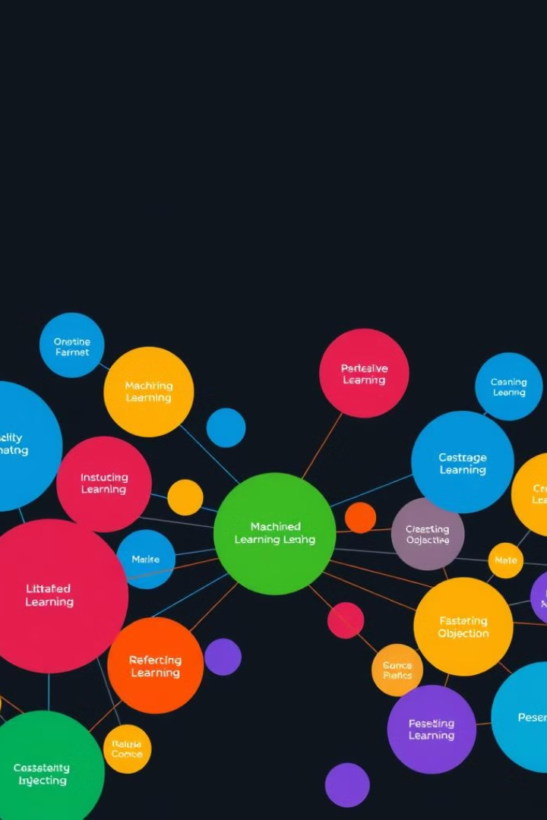
Project Objectives
1
Data Collection
Collect and clean dataset, implement preprocessing using scikit-learn pipelines.
2
Recommendation Models
Develop deep learning-based models using GANs and autoencoders.
3
Model Evaluation
Optimize performance using MSE, RMSE, and MAE metrics.
4
API Deployment
Deploy system using FastAPI for real-time movie recommendations.

Slide 3

Data Collection and Preprocessing
1
Data Collection
Collected and cleaned movie-related data, including user ratings, titles, and IDs.
2
Preprocessing Pipeline
Created pipelines for numerical and categorical features using scikit-learn.
3
Deliverables
Produced cleaned dataset and preprocessing pipeline (all_pipeline.pkl).

Slide 4
Building Recommendation Models
GAN-based Model
Autoencoder
Deliverables
Implemented for generating user-item matrices and predicting movie ratings.
Developed to learn and compress user preferences into latent vectors.
Trained GAN and autoencoder models (generator_model.pkl, latent_vectors.npy).

Slide 5
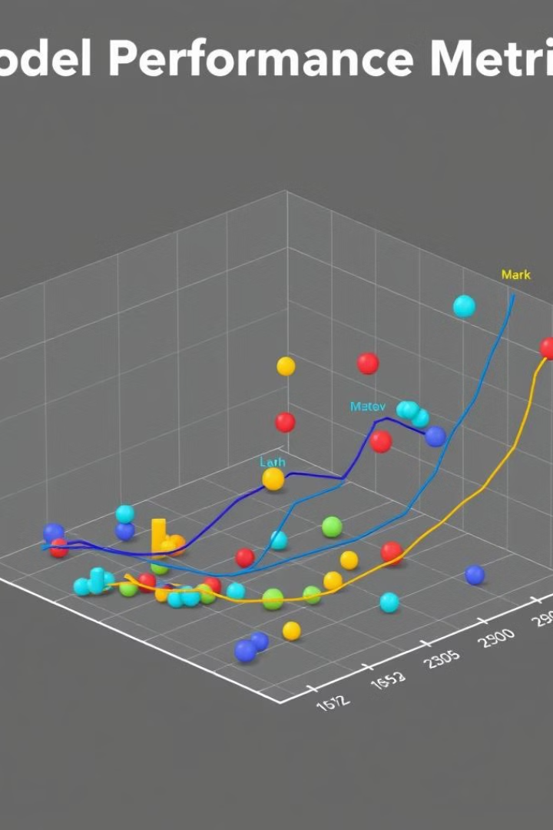
Model Evaluation and Optimization
Performance Metrics
Evaluated using MSE, RMSE, and MAE for optimal accuracy.
Data Partitioning
Used train_test_split for 80-20 data partitioning.
Hyperparameter Tuning
Optimized model parameters for improved performance.

Slide 6
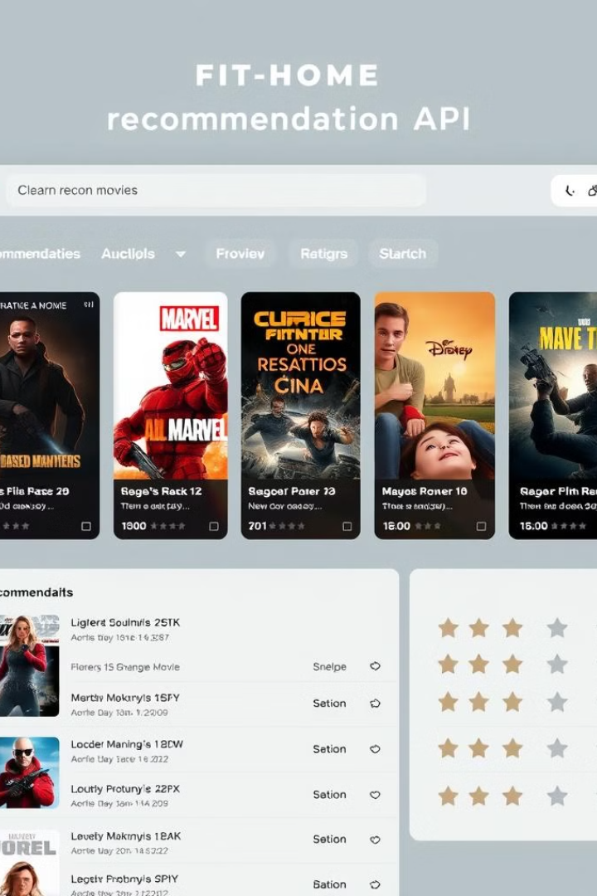



API Deployment and Documentation
FastAPI Deployment
Deployed system to provide real-time recommendations based on user input.
Documentation
Prepared comprehensive project documentation and final deliverables.
Real-time Service
Integrated recommendation system into FastAPI backend for user interactions.

Slide 7





Tools and Technologies
Python
TensorFlow
Primary programming language for development.
Used for implementing deep learning models.
Scikit-learn
FastAPI
Utilized for data preprocessing and model evaluation.
Employed for API deployment and real-time predictions.

Slide 8
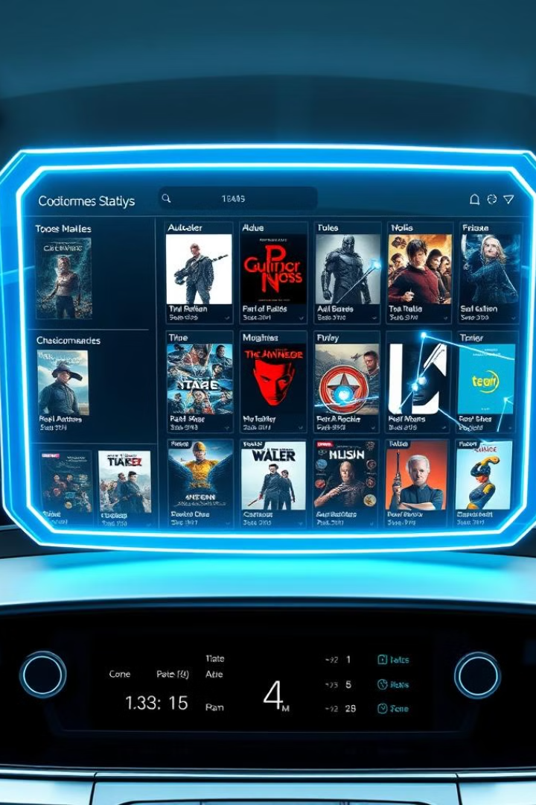
Current Status and Conclusion
Data Collection
Completed
Modeling
GAN and autoencoder models implemented
API Deployment
System deployed using FastAPI
Recommendation System
Functional, delivering personalized suggestions

